Slide 1



Next Gen Employability Program
Full Stack Web Development with AI Tools
Team Details – Team ID
Sai Venkat
Rohith
Jyoshna
Komala
Rachana
College: Vaagdevi College Of Engineering

Slide 2

The content is curated from online/offline resources and used for educational purpose only.
Notes:
Speaker would be briefing the students that this content has been prepared for the educational purpose only and is referred from multiple sites which are cited in the last.​​
---------------------------------------------------​​
A disclaimer is a statement or notice that is intended to clarify, limit, or provide information about the scope, limitations, or potential risks associated with certain actions, information, products, services, or content. ​​
​​
​

Slide 3

Project Title
SMART PHARMACY MANAGEMENT SYSTEM
Notes:
In this slide speaker will be introducing the program and its outcomes. The speaker will introduce himself in brief

Slide 4

Table of Contents
Introduction
Related Works
Problem Statement
Existing System
Proposed System
References
Notes:
This slide, The speaker will talk about the content that we will be covering in this session as follows:
Introduction
Importance of UI/UX in industry
History and Definitions of UI and UX
Key Differences between UI/UX
Use Cases
Significance in Web Development
Use Cases
Visual Design Principles
Design process
Color theory and psychology
Typography and readability
Layout and Spacing
Responsive design basics
Usability and Accessibility
Usability Aspects
Web Content Accessibility Guidelines (WCAG)
Inclusive design practices
Consistency
User Experience
User-Centered Design
User research methods
Interactive Elements and Feedback
Mini Case Study
Discussing a popular UI/UX design
Hands-On
Introduction to Figma for UI/UX design

Slide 5
Introduction In today’s rapidly evolving healthcare environment, pharmacies play a crucial role in ensuring safe, accurate. However, traditional pharmacy operations often face challenges such as manual errors, inefficient inventory handling, delayed service, and lack of real-time monitoring. To address these issues, Smart Pharmacy Management Systems have emerged as an innovative solution that integrates modern technologies—including automation, data analytics, and digitalrecord-keeping—into daily pharmaceutical workflows. By digitizing and streamlining core processes such as prescription management, stock monitoring, and medication dispensing, smart pharmacy systems enhance operational efficiency and improve patient safety.
Notes:
This slide, The speaker will talk about the content that we will be covering in this session as follows:
Introduction
Importance of UI/UX in industry
History and Definitions of UI and UX
Key Differences between UI/UX
Use Cases
Significance in Web Development
Use Cases
Visual Design Principles
Design process
Color theory and psychology
Typography and readability
Layout and Spacing
Responsive design basics
Usability and Accessibility
Usability Aspects
Web Content Accessibility Guidelines (WCAG)
Inclusive design practices
Consistency
User Experience
User-Centered Design
User research methods
Interactive Elements and Feedback
Mini Case Study
Discussing a popular UI/UX design
Hands-On
Introduction to Figma for UI/UX design

Slide 6
Related Works Systems that Track Expiry Dates Automatically Researchers have created systems that show expired medicines in red color on a computer or mobile screen. When a medicine expires, the system automatically changes its color to red. No need for staff to check expiry dates manually. Automated Inventory Systems Many studies focus on using barcode or RFID technology to track medicines automatically. These systems help reduce stock shortages and make inventory updates faster and more accurate. Automatic Stock and Sales Management Systems Several works show software that handles: Inventory (stock) Daily sales Reports These systems update everything automatically when a sale happens—no manual entry needed.
Notes:
This slide, The speaker will talk about the content that we will be covering in this session as follows:
Introduction
Importance of UI/UX in industry
History and Definitions of UI and UX
Key Differences between UI/UX
Use Cases
Significance in Web Development
Use Cases
Visual Design Principles
Design process
Color theory and psychology
Typography and readability
Layout and Spacing
Responsive design basics
Usability and Accessibility
Usability Aspects
Web Content Accessibility Guidelines (WCAG)
Inclusive design practices
Consistency
User Experience
User-Centered Design
User research methods
Interactive Elements and Feedback
Mini Case Study
Discussing a popular UI/UX design
Hands-On
Introduction to Figma for UI/UX design

Slide 7
Problem statement: Now a days, Pharmacies facing problems in managing operations such as visualization about the stock , expiry date color, hand written prescription , Manual record keeping, human dependent decision making. To avoid these problems we can use smart pharmacy automated system for visualization to represent the tablet turning red mark if it is expired and day to day automatically data will be updated in graphically.
Notes:
This slide, The speaker will talk about the content that we will be covering in this session as follows:
Introduction
Importance of UI/UX in industry
History and Definitions of UI and UX
Key Differences between UI/UX
Use Cases
Significance in Web Development
Use Cases
Visual Design Principles
Design process
Color theory and psychology
Typography and readability
Layout and Spacing
Responsive design basics
Usability and Accessibility
Usability Aspects
Web Content Accessibility Guidelines (WCAG)
Inclusive design practices
Consistency
User Experience
User-Centered Design
User research methods
Interactive Elements and Feedback
Mini Case Study
Discussing a popular UI/UX design
Hands-On
Introduction to Figma for UI/UX design

Slide 8
Existing System
In the existing (traditional) pharmacy system, most tasks are performed manually. Pharmacists physical stock registers, and manual checking of expiry dates. Inventory updates are slow and often inaccurate because they depend on human observation. Medicines nearing expiry are difficult to track, leading to wastage and financial loss. Since there is no automated alert system, pharmacists must individually check each product, which is time-consuming and prone to errors. Overall, the existing system lacks efficiency, accuracy, and real-time monitoring.

Slide 9
Proposed System
The proposed system introduces a Smart Pharmacy Management System that automates inventory handling, expiry tracking, and dispensing processes. It uses digital tools to store medicine data , and stock information. One of the key features is the expiry date color-coding method, where medicines are automatically highlighted with red color when it is expired . This helps pharmacists easily identify and remove expiry products.
By digitizing the workflow—stock tracking, and sales reporting—the proposed system ensures faster service, improved accuracy, reduced wastage, and overall better pharmacy efficiency.

Slide 10
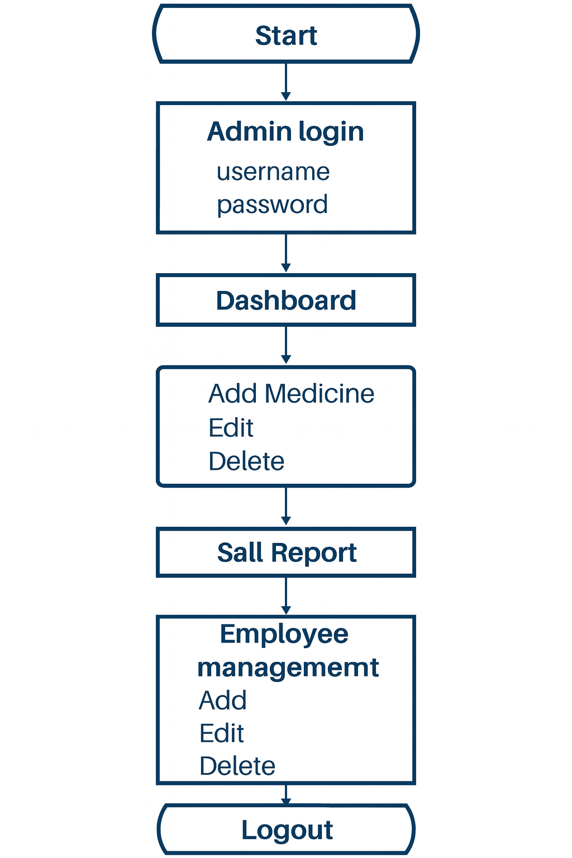

Slide 11
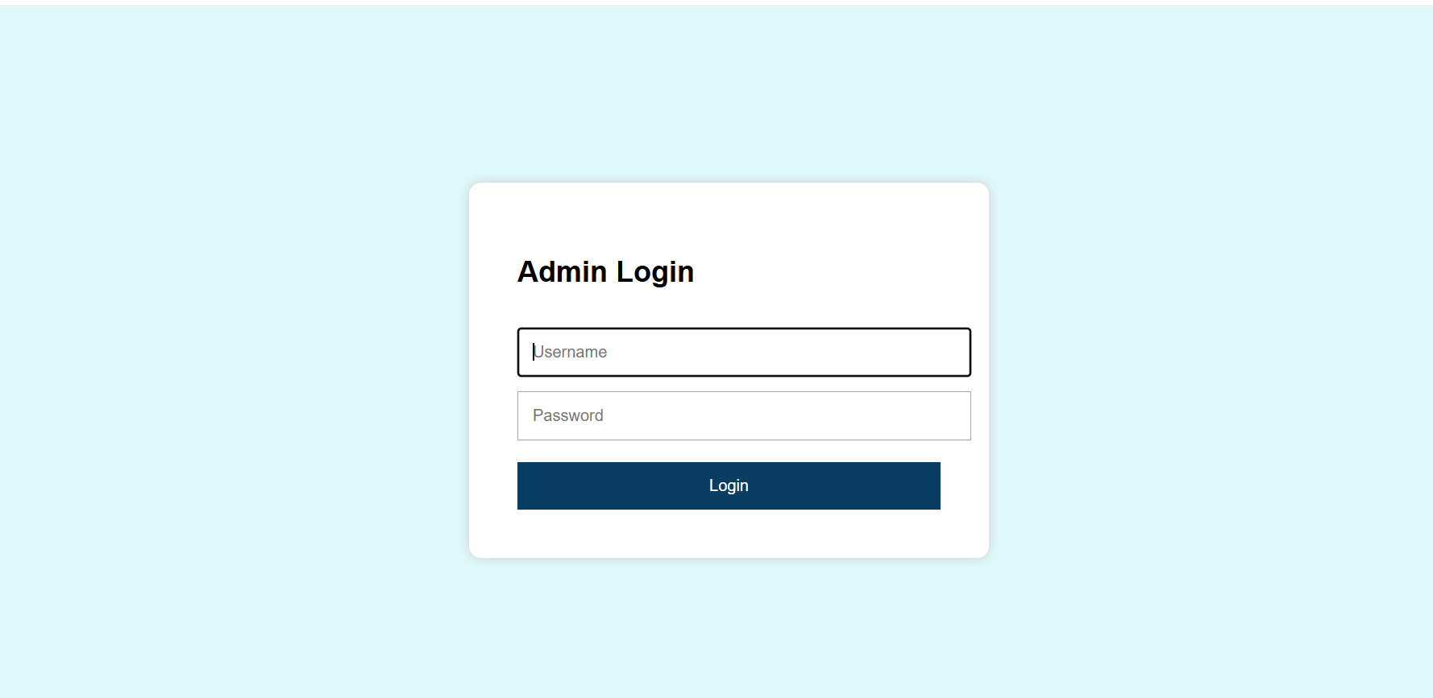

Slide 12
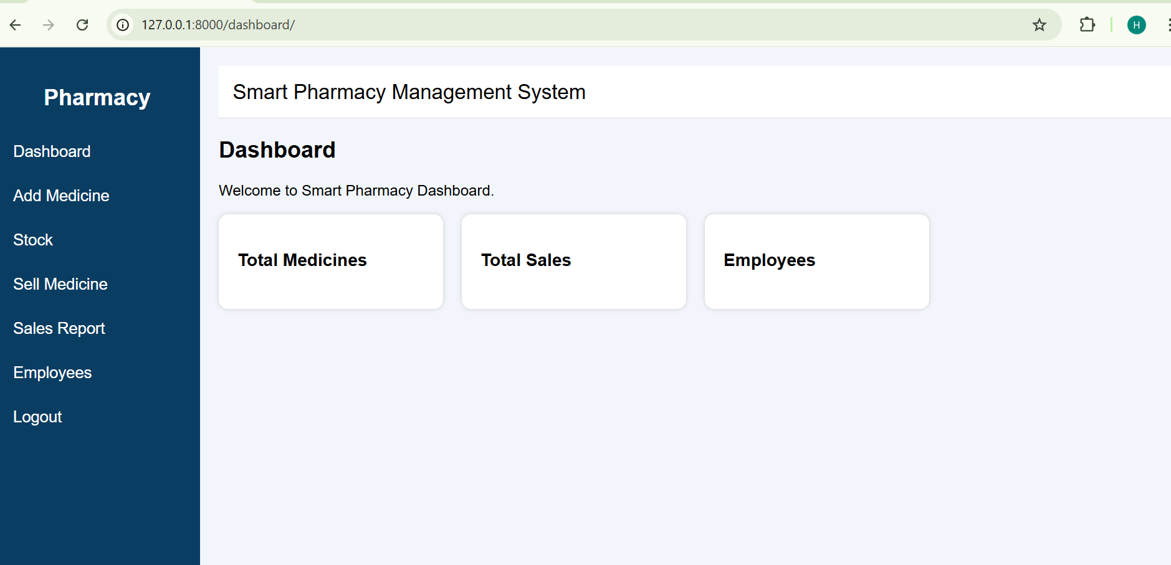

Slide 13
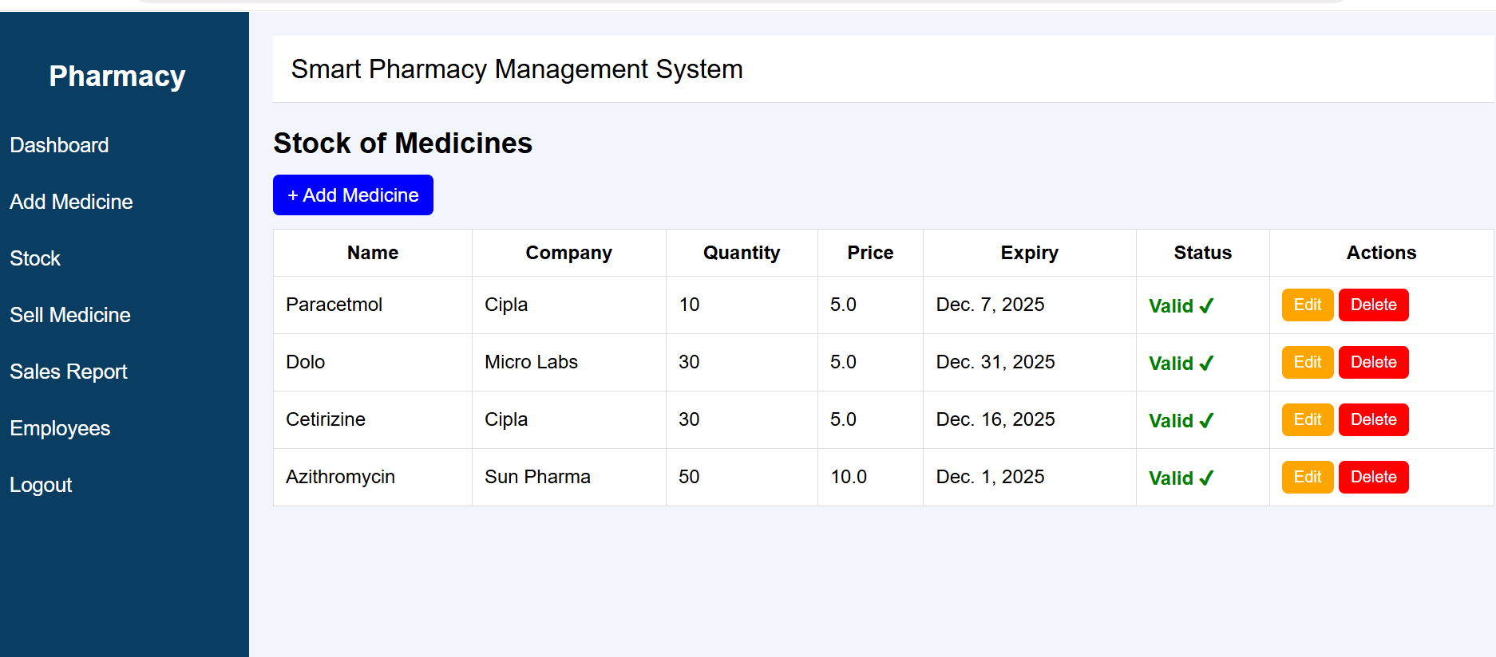

Slide 14
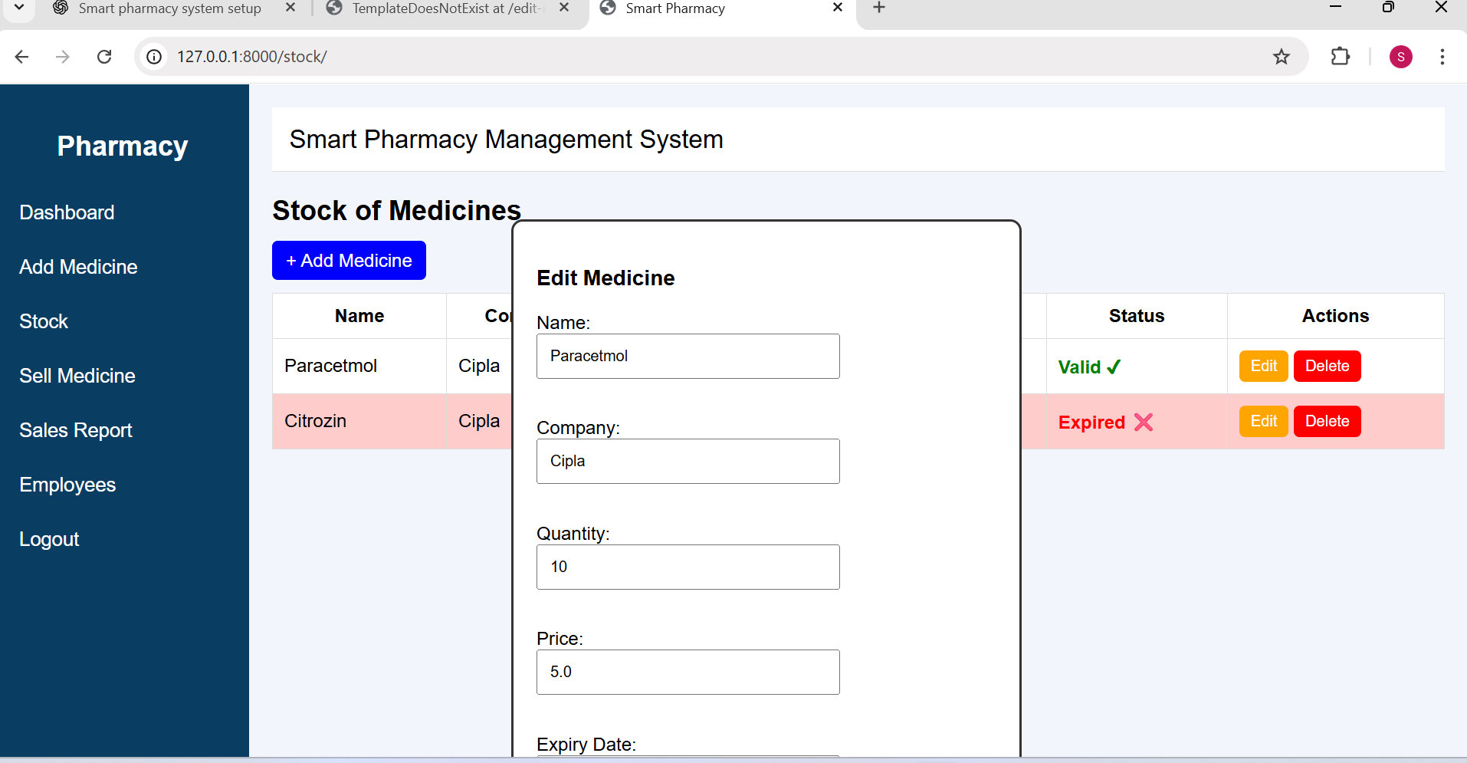

Slide 16
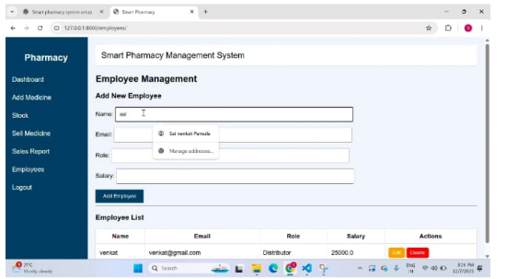

Slide 17
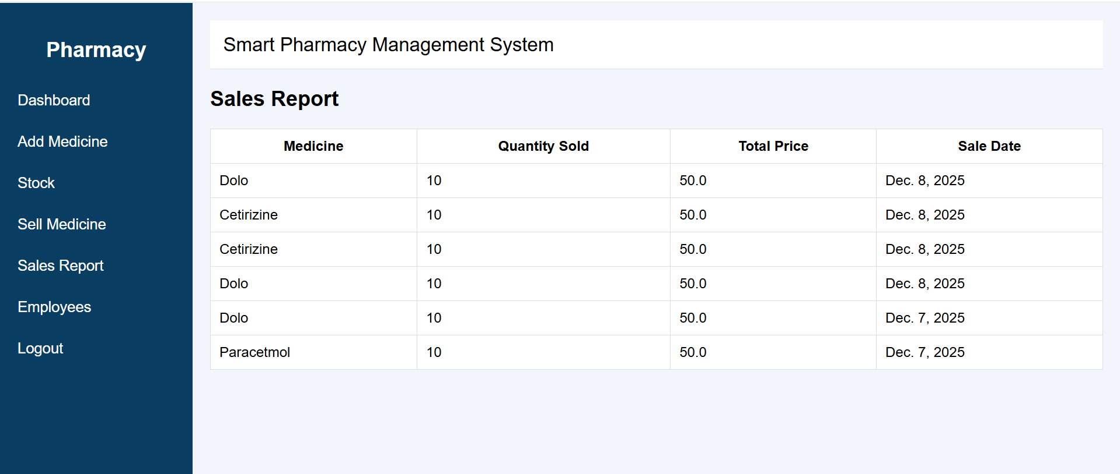

Slide 18
Future Enhancement:
Artificial Intelligence (AI) and Machine Learning (ML): Integrating AI and ML capabilities to predict patient needs, optimize inventory levels, and improve customer service.2
Mobile Applications: Developing mobile applications for customers to order medications, access their prescription history, and receive reminders.
Telepharmacy: Integrating telepharmacy services to enable remote consultations and prescription filling.
Wearable Devices and IoT Integration: Integrating wearable devices and IoT sensors to track patient health metrics and provide real-time insights.
5. Blockchain Technology: Exploring the use of blockchain technology to improve data security and integrity.

Slide 19
Conclusion:
The Smart Pharmacy Management System is a comprehensive solution for managing pharmacy operations efficiently. By automating tasks, reducing errors, and improving customer satisfaction, the system can help pharmacies provide better care to their customers. With its advanced features and capabilities, the Smart Pharmacy Management System is poised to revolutionize the pharmacy industry.

Slide 20
References
A. Kumar, “Study on Automated Inventory and Prescription Management in Pharmacies,” International
Journal of Pharmacy Practice and Education, vol. 5, no. 2, pp. 18–24, 2019.
M. Patel and J. Shah, “Web-Based Pharmacy Management System with Inventory Control,” International Journal of Advanced Research in Computer Science, vol. 9, no. 3, pp. 55–61, 2018.

Slide 21
Thank You

